Slide 1

SP500_PRICE_prediction
Jinxiang Yu

Slide 2
Problem statement
Predict SP500_Index Future Price
Method: Time Series
Feature Engineering
Lags and Moving Average
Target Variable: Adj Close

Slide 3
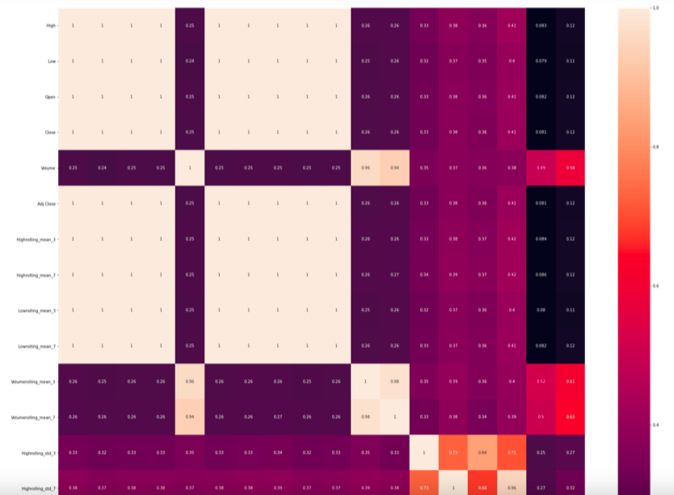
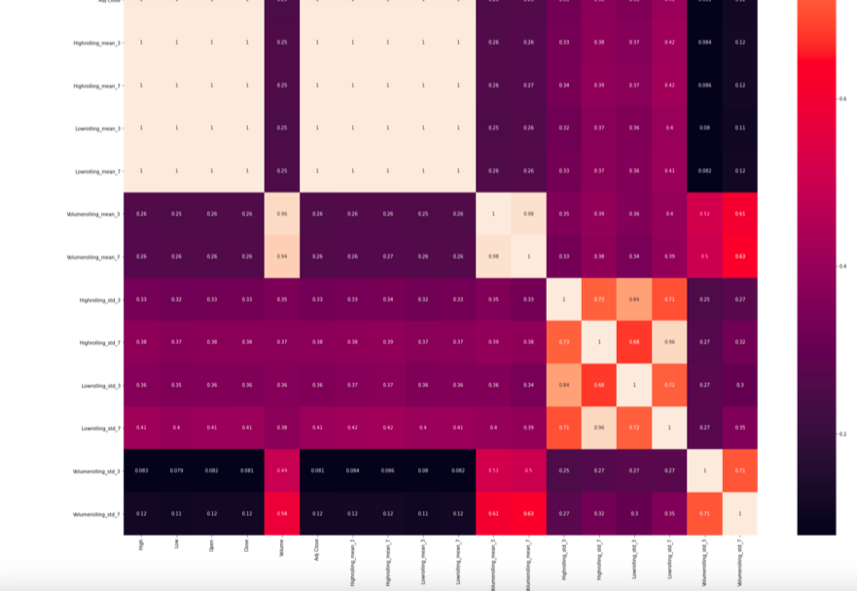
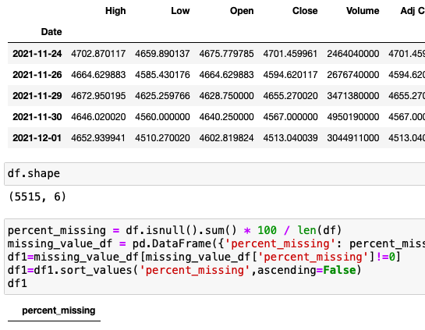
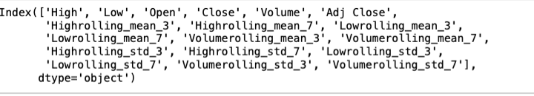
Data preprocessing & feature engineering moving average, open, high, low, standard deviation are high correlated, finally decided to use time, volume and moving average as independent variables

Slide 4
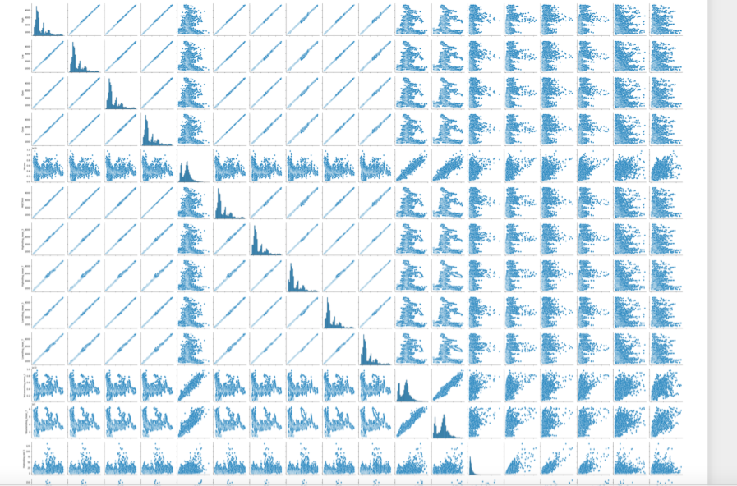
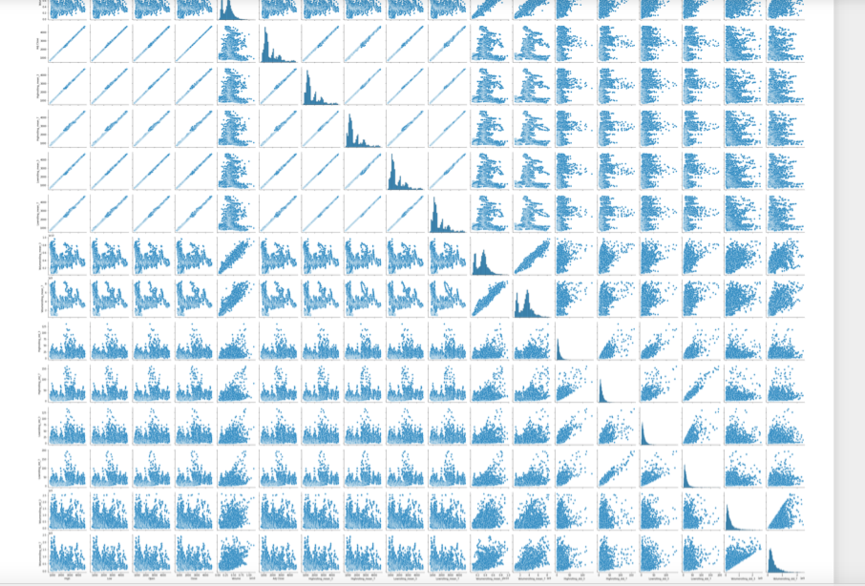
Eda (Scatter plot: Left Skewed)

Slide 5
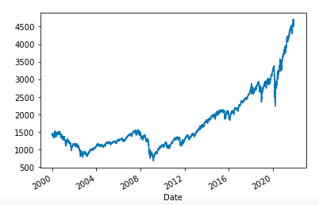
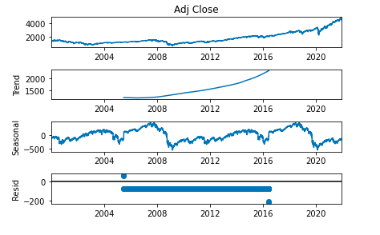
Plot of ADJ Close

Slide 6
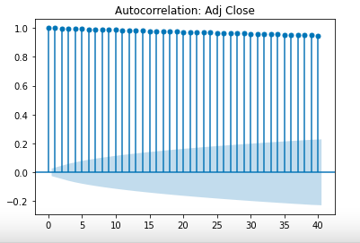
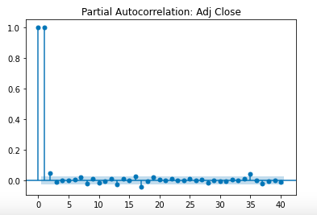
ACF&PACF of adj close

Slide 7
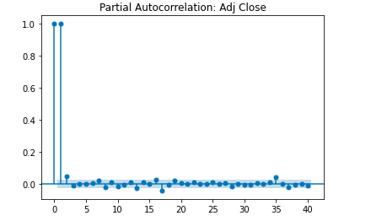
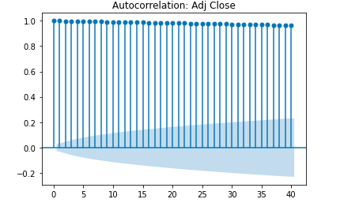
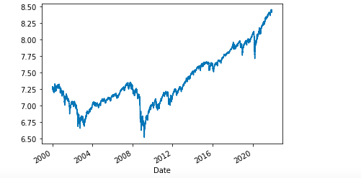
LOG of adj close (SPSS: 0.01)

Slide 8
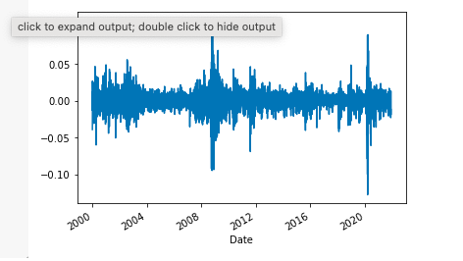
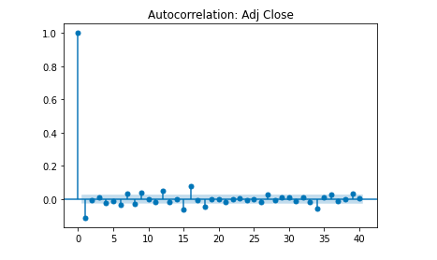
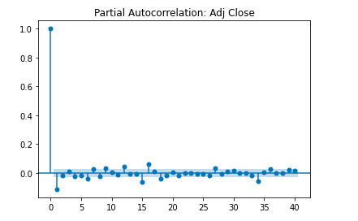
DIFF OF ADJ CLOSE (SPSS: 0.068)

Slide 9
DICKY FULLER TEST (P-VALUE)
ADJ-CLOSE: 0.99
Y-DIFF: 8.670139e-26

Slide 10
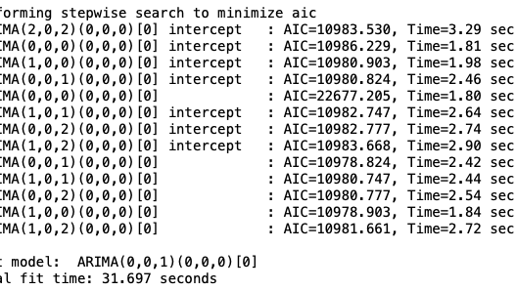
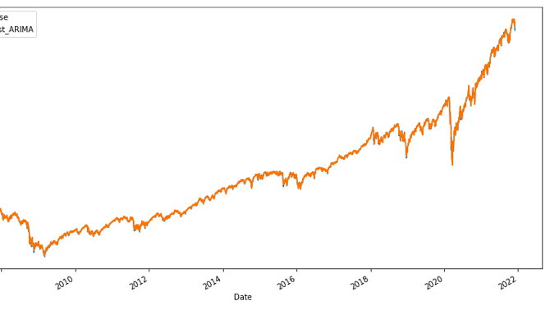
TIME SERIES
MAE: 5.56
RMSE: 8.65
MAPE: 0.003

